Slide 1

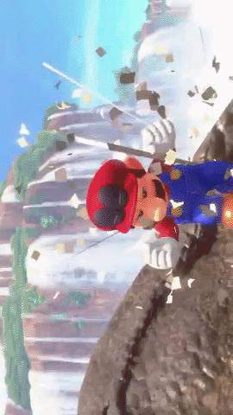
CSCI-6660-02 -
Introduction to Artificial Intelligence
Instructor : Shivanjali Khare
IMPLEMENTING REINFORCEMENT LEARNING IN GAMING
Done by : Alla Venkata Siddhardha (00858414)
Macha Padmini (00877142)

Slide 2


Introduction
To train an autonomous Mario agent, employ Double Deep Q-Networks within the OpenAI Gym environment designed
for Super Mario Bros using the nes-py emulator.
Monitor the Mean reward, Mean loss, and Mean Q values over a series of episodes during the training process.
The goal is to simulate the iterative refinement of the Mario Agent's skills, enabling it to navigate the game environment
effectively.

Slide 3
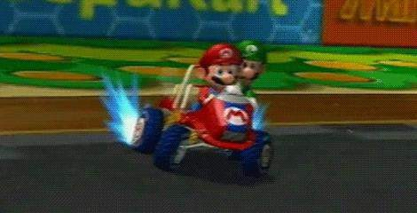
Reinforcement learning constitutes a machine learning technique that revolves around rewarding desired behaviors while penalizing undesired ones.
REINFORCEMENT LEARNING
At its core, a reinforcement learning agent possesses the capability to perceive and interpret its surroundings, take actions, and refine its behavior through experiential learning.
The foundation of reinforcement learning systems lies in the Markov decision process, where an agent operates within a defined state within its environment.
Within this process, the agent must discern the optimal action from a set of available actions based on its current state.
Certain actions yield rewards, serving as motivational cues for the agent.
As the agent transitions to subsequent states, new actions with potential rewards become accessible.
Over time, the cumulative reward aggregates, representing the sum of rewards accrued from the agent's chosen actions.

Slide 4

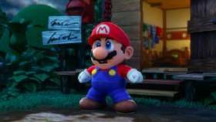

Key Components
Agent: An actor within an unpredictable environment, responding to rewards.
Environment: The external system with which the agent interacts, offering feedback based on its actions.
Action (a): The array of potential moves or decisions the agent can undertake in any given state.
State (s): The present condition of the environment. The collection of all conceivable states the Environment may occupy is referred to as the state-space
Reward (r): A numerical feedback provided by the environment in response to the agent's action within a specific state, aiming to optimize the cumulative reward over time.
Policy: A strategic approach or mapping from states to actions utilized by the agent for decision-making purposes.
Optimal Action-Value function Q*(s,a): Predicts the anticipated return when commencing from state s, executing a chosen action a, and subsequently selecting actions that maximize returns in future time steps. Q denotes the effectiveness of an action within a state, which is approximated during the learning process

Slide 5

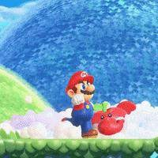
Tools and Packages
Setting Up Mario Environment
Performed on: Anaconda-Jupyter Lab
Framework: Gym - A toolkit employed for developing and comparing Reinforcement Learning (RL) algorithms, facilitating training agents in various tasks such as walking and playing games.
Environment: gym-super-mario-bros==7.3.0
Platform: Pytorch
Actions: (joypad space) - Utilizes nes-py, an NES emulator and OpenAI Gym interface, to create a virtual joypad for playing the Mario game.
Wrappers: Preprocessing tools applied to the environment
data before transmission to the agent.

Slide 6

A G E N T
Creating a Mario class to serve as our
agent within the game.
Acting in accordance with the optimal action policy determined by the current
state of the environment.
Logging experiences, comprising the current state, action taken, received
reward, and subsequent state, to
facilitate learning.
Iteratively refining the action policy
through training.
In any given state, the agent can opt for the most advantageous action when exploiting or select a random action
when exploring.

Slide 7
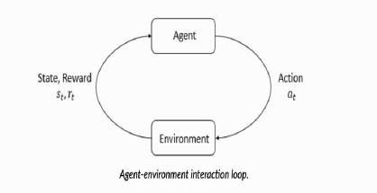
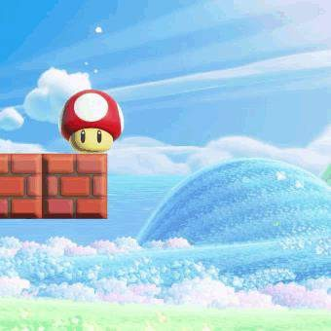




Training Model
Mario uses DDQN algorithm (Deep Reinforcement Learning with Double Q-learning) - uses two
convoluted networks that independently approximate
the optimal action-value function
Predicted Optimal Q* for each state and
►
The aggregation of current rewards and estimated Q*
is given by

Slide 8


Implement and compare model-free RL Algorithm
Policy gradient methods belong to the realm of reinforcement learning techniques, focusing on optimizing parameterized policies to enhance the expected return (cumulative reward over the long term) through gradient descent.
In the context of a stochastic, parameterized policy, the goal is to maximize the anticipated return.
Implementing this algorithm involves two primary steps:
Deriving the analytical gradient of policy performance, which takes the form of an expected value.
Generating a sample estimate of this expected value, feasible through data obtained from a finite number of interactions between the agent and the environment

Slide 9
OUTPUT

Slide 10
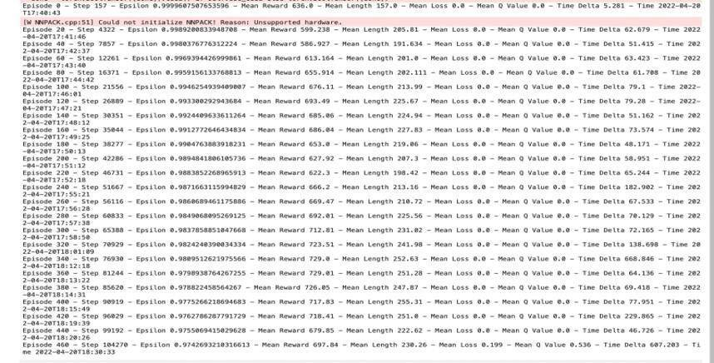

Slide 11
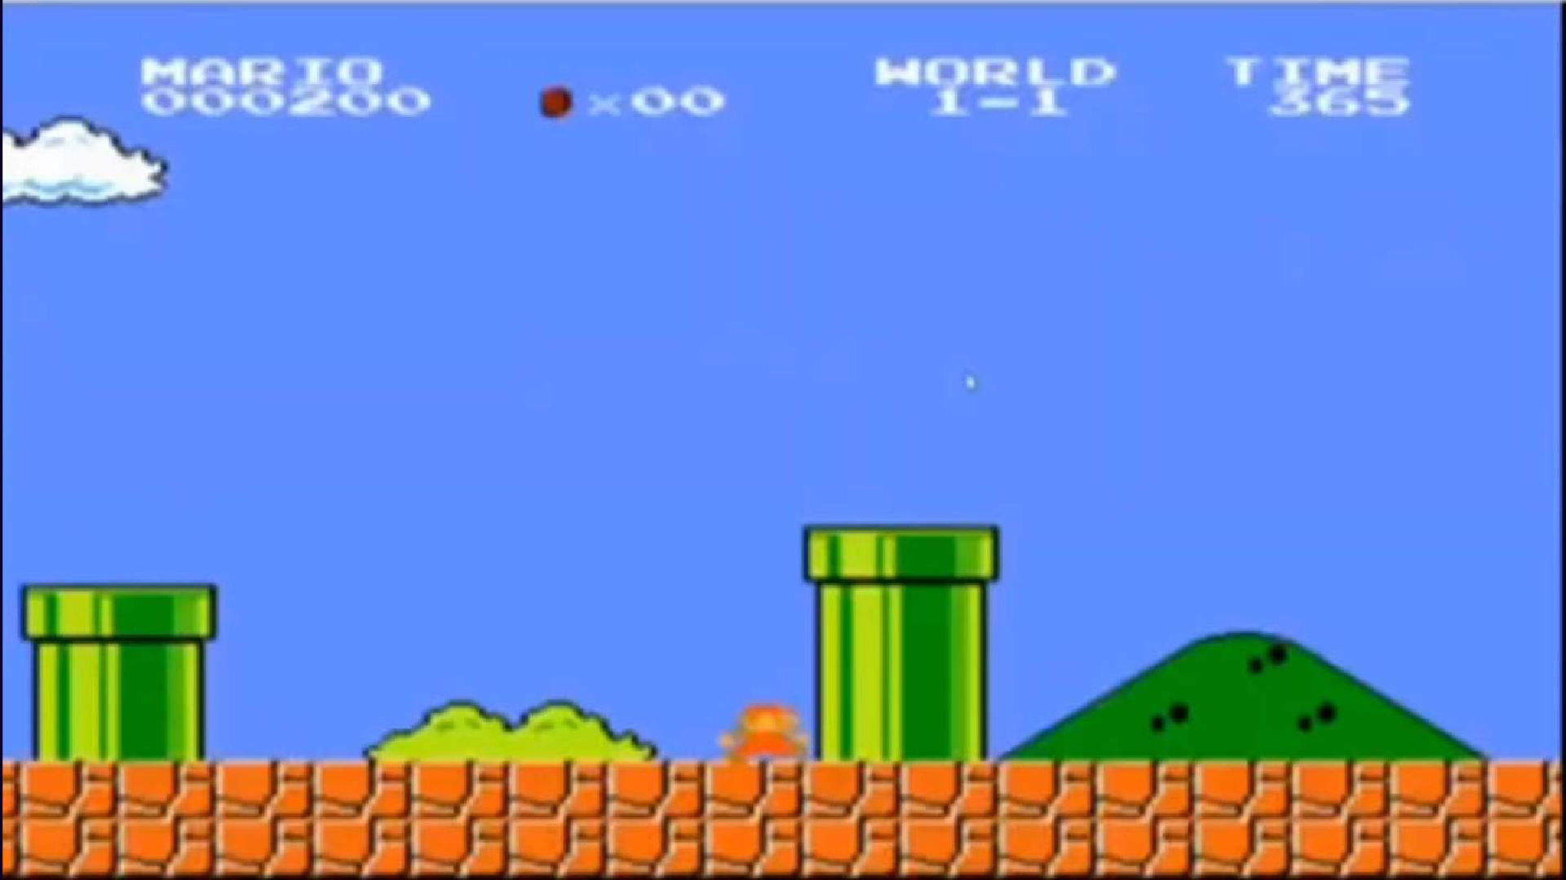

Slide 12
Inference
12
Practical Implementation of Reinforcement Learning:
We've observed how the practical application of reinforcement learning (RL) can be utilized to construct a
learning framework within an environment and effectively train an agent.
Potential Applications:
RL demonstrates versatile applications in various domains, including:
Autonomous Vehicles Industrial Automation Financial Trading Customized Suggestions
Natural Language Processing (NLP)

Slide 13
References
Paper on Deep Reinforcement Learning with Double Q-learning -
https://arxiv.org/pdf/1509.06461.pdf
Toolkit resource- Gym (openai.com)
RL learning guide- Reinforcement Learning Tips and Tricks — Stable Baselines3 1.5.1a4 documentation (stable- baselines3.readthedocs.io)
Reinforcement Learning: An Introduction, Richard S. Sutton et al. SuttonBartoIPRLBook2ndEd.pdf (stanford.edu)
Key concepts of RL
Part 1: Key Concepts in RL — Spinning Up documentation (openai.com)

Slide 14

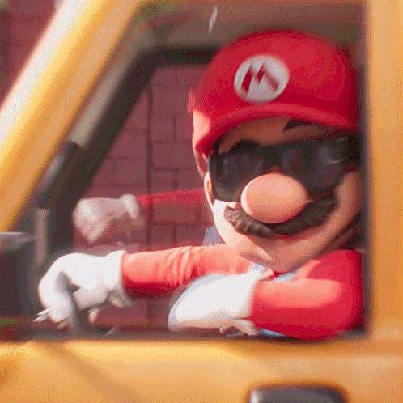

THANK YOU

